Slide 1
SEQUENTIAL COUNTER with UNUSED STATE
EXAMPLE 1
LECTURE 12

Slide 2
STATE DIAGRAM
00
UNUSED
STATE
01
10
11

Slide 3




STATE DIAGRAM
UNUSED
STATE
$${Q_{1}Q}_{0}$$
0 0
$${Q_{1}Q}_{0}$$
1 0
$${Q_{1}Q}_{0}$$
0 1
$${Q_{1}Q}_{0}$$
1 1

Slide 4
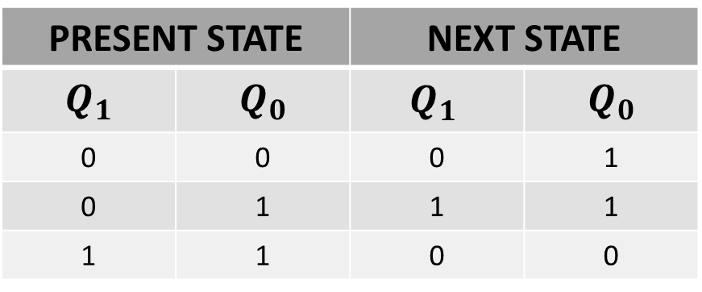
NEXT STATE TABLE
PRESENT STATE |  | NEXT STATE
$$Q_{1}$$ | $$Q_{0}$$ | $${Q_{1}}_{ }$$ | $$Q_{0}$$
0 | 0 | 0 | 1
0 | 1 | 1 | 1
1 | 1 | 0 | 0

Slide 5
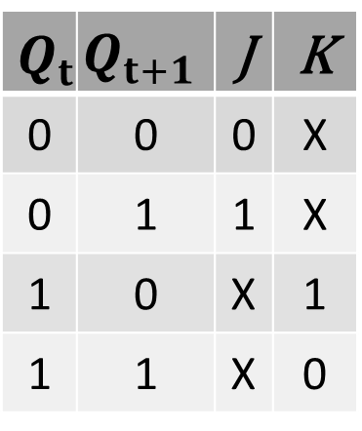
NEXT STATE TABLE USING JK FLIP FLOP
$$Q_{t}$$ | $$Q_{t+1}$$ | J | K
0 | 0 | 0 | X
0 | 1 | 1 | X
1 | 0 | X | 1
1 | 1 | X | 0

Slide 6
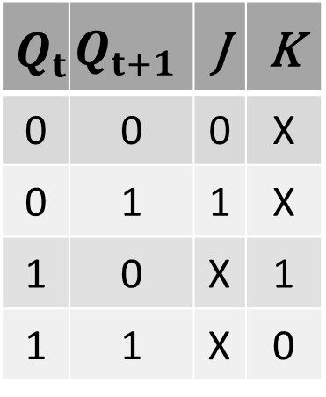
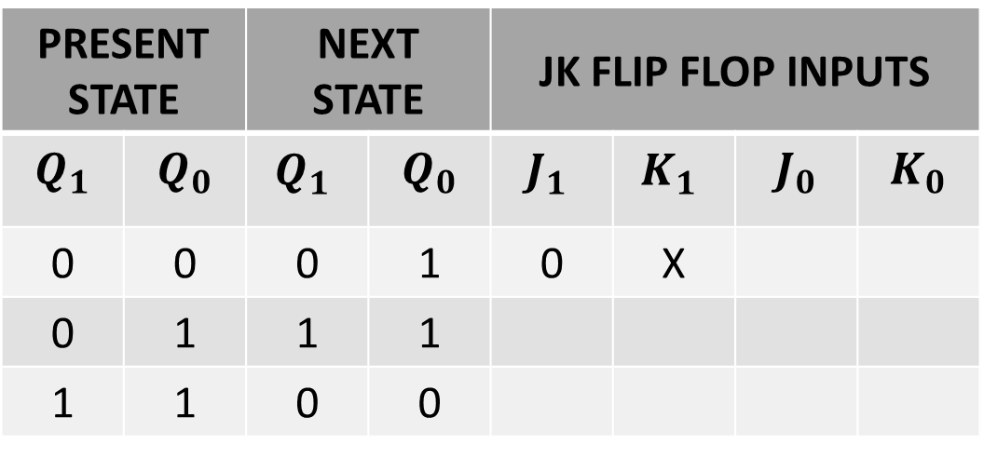
NEXT STATE TABLE
$$Q_{t}$$ | $$Q_{t+1}$$ | J | K
0 | 0 | 0 | X
0 | 1 | 1 | X
1 | 0 | X | 1
1 | 1 | X | 0
PRESENT STATE |  | NEXT STATE |  | JK FLIP FLOP INPUTS
$$Q_{1}$$ | $$Q_{0}$$ | $${Q_{1}}_{ }$$ | $$Q_{0}$$ | $${J_{1}}_{ }$$ | $${K_{1}}_{ }$$ | $$J_{0}$$ | $$K_{0}$$
0 | 0 | 0 | 1 | 0 | X
0 | 1 | 1 | 1
1 | 1 | 0 | 0

Slide 7
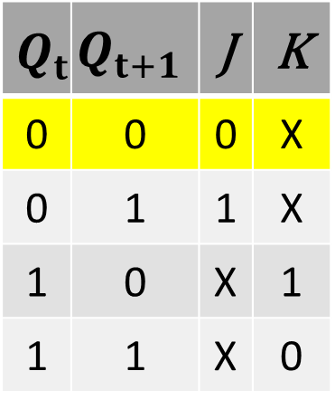
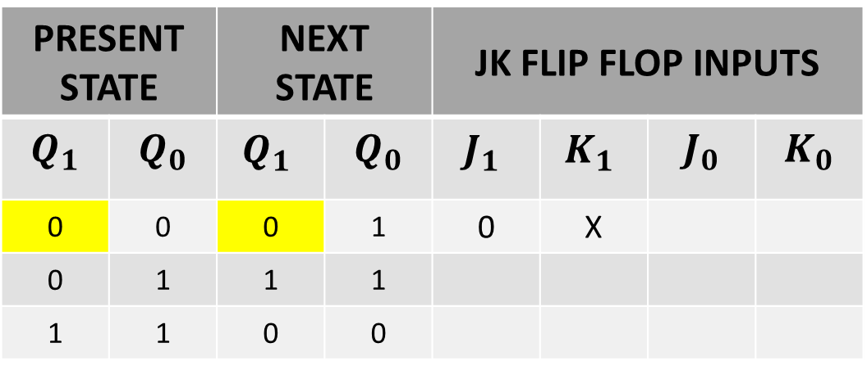
NEXT STATE TABLE
$$Q_{t}$$ | $$Q_{t+1}$$ | J | K
0 | 0 | 0 | X
0 | 1 | 1 | X
1 | 0 | X | 1
1 | 1 | X | 0
PRESENT STATE |  | NEXT STATE |  | JK FLIP FLOP INPUTS
$$Q_{1}$$ | $$Q_{0}$$ | $${Q_{1}}_{ }$$ | $$Q_{0}$$ | $${J_{1}}_{ }$$ | $${K_{1}}_{ }$$ | $$J_{0}$$ | $$K_{0}$$
0 | 0 | 0 | 1 | 0 | X
0 | 1 | 1 | 1
1 | 1 | 0 | 0

Slide 8
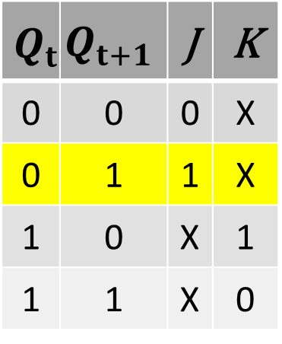
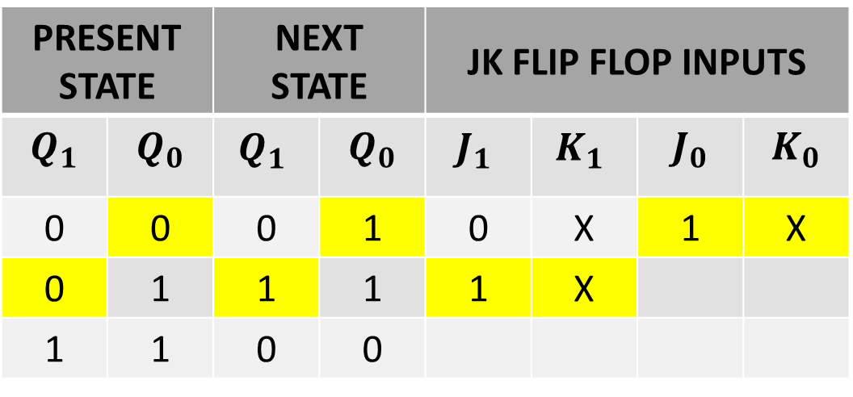
NEXT STATE TABLE
$$Q_{t}$$ | $$Q_{t+1}$$ | J | K
0 | 0 | 0 | X
0 | 1 | 1 | X
1 | 0 | X | 1
1 | 1 | X | 0
PRESENT STATE |  | NEXT STATE |  | JK FLIP FLOP INPUTS
$$Q_{1}$$ | $$Q_{0}$$ | $${Q_{1}}_{ }$$ | $$Q_{0}$$ | $${J_{1}}_{ }$$ | $${K_{1}}_{ }$$ | $$J_{0}$$ | $$K_{0}$$
0 | 0 | 0 | 1 | 0 | X | 1 | X
0 | 1 | 1 | 1 | 1 | X
1 | 1 | 0 | 0

Slide 9
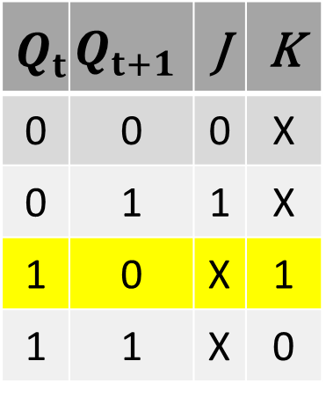
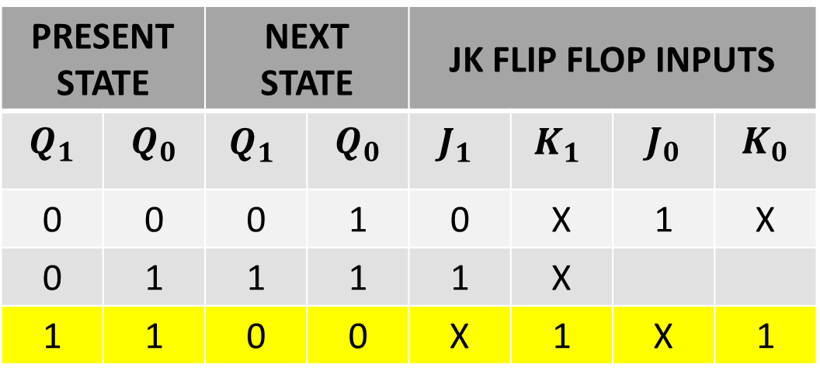
NEXT STATE TABLE
$$Q_{t}$$ | $$Q_{t+1}$$ | J | K
0 | 0 | 0 | X
0 | 1 | 1 | X
1 | 0 | X | 1
1 | 1 | X | 0
PRESENT STATE |  | NEXT STATE |  | JK FLIP FLOP INPUTS
$$Q_{1}$$ | $$Q_{0}$$ | $${Q_{1}}_{ }$$ | $$Q_{0}$$ | $${J_{1}}_{ }$$ | $${K_{1}}_{ }$$ | $$J_{0}$$ | $$K_{0}$$
0 | 0 | 0 | 1 | 0 | X | 1 | X
0 | 1 | 1 | 1 | 1 | X
1 | 1 | 0 | 0 | X | 1 | X | 1

Slide 10
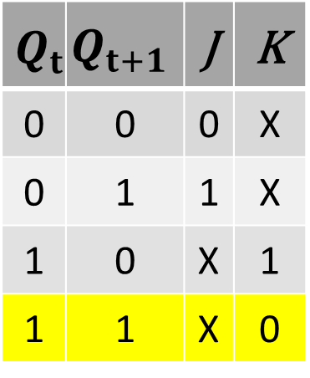
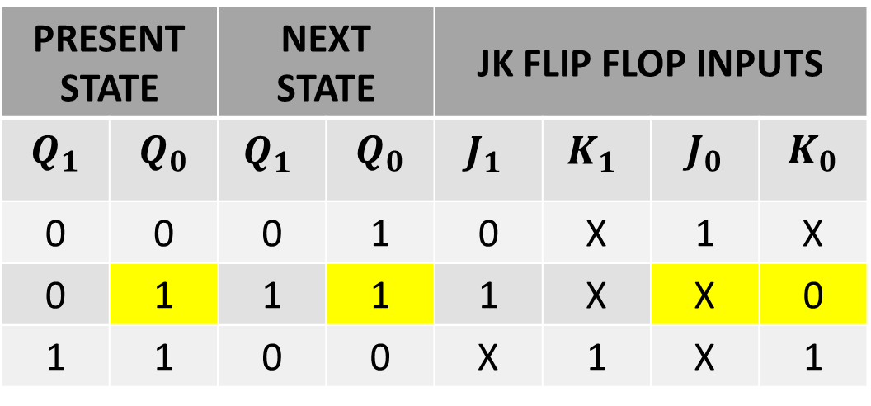
NEXT STATE TABLE
$$Q_{t}$$ | $$Q_{t+1}$$ | J | K
0 | 0 | 0 | X
0 | 1 | 1 | X
1 | 0 | X | 1
1 | 1 | X | 0
PRESENT STATE |  | NEXT STATE |  | JK FLIP FLOP INPUTS
$$Q_{1}$$ | $$Q_{0}$$ | $${Q_{1}}_{ }$$ | $$Q_{0}$$ | $${J_{1}}_{ }$$ | $${K_{1}}_{ }$$ | $$J_{0}$$ | $$K_{0}$$
0 | 0 | 0 | 1 | 0 | X | 1 | X
0 | 1 | 1 | 1 | 1 | X | X | 0
1 | 1 | 0 | 0 | X | 1 | X | 1

Slide 11
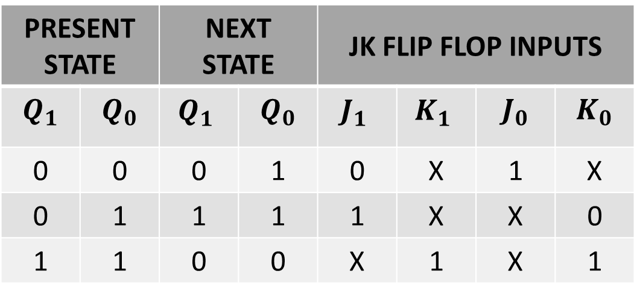
NEXT STATE TABLE
$$Q_{t}$$ | $$Q_{t+1}$$ | J | K
0 | 0 | 0 | X
0 | 1 | 1 | X
1 | 0 | X | 1
1 | 1 | X | 0
PRESENT STATE |  | NEXT STATE |  | JK FLIP FLOP INPUTS
$$Q_{1}$$ | $$Q_{0}$$ | $${Q_{1}}_{ }$$ | $$Q_{0}$$ | $${J_{1}}_{ }$$ | $${K_{1}}_{ }$$ | $$J_{0}$$ | $$K_{0}$$
0 | 0 | 0 | 1 | 0 | X | 1 | X
0 | 1 | 1 | 1 | 1 | X | X | 0
1 | 1 | 0 | 0 | X | 1 | X | 1

Slide 12
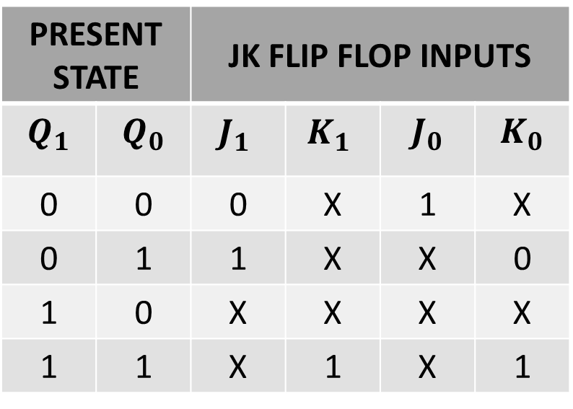
NEXT STATE TABLE
$$Q_{t}$$ | $$Q_{t+1}$$ | J | K
0 | 0 | 0 | X
0 | 1 | 1 | X
1 | 0 | X | 1
1 | 1 | X | 0
PRESENT STATE |  | JK FLIP FLOP INPUTS
$$Q_{1}$$ | $$Q_{0}$$ | $${J_{1}}_{ }$$ | $${K_{1}}_{ }$$ | $$J_{0}$$ | $$K_{0}$$
0 | 0 | 0 | X | 1 | X
0 | 1 | 1 | X | X | 0
1 | 0 | X | X | X | X
1 | 1 | X | 1 | X | 1

Slide 13
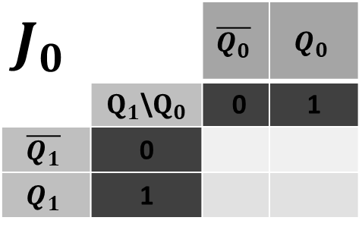
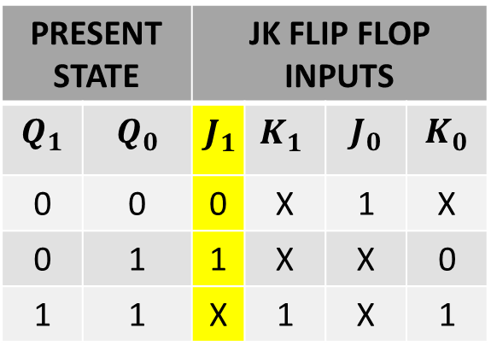
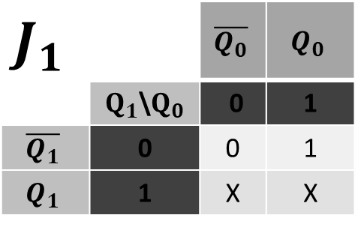
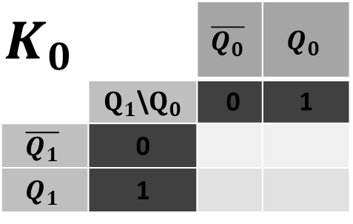
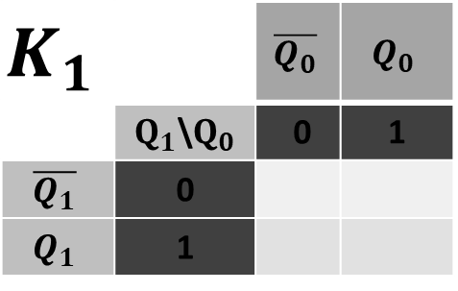
SIMPLIFICATION(K-MAP)
PRESENT STATE |  | JK FLIP FLOP INPUTS
$$Q_{1}$$ | $$Q_{0}$$ | $${J_{1}}_{ }$$ | $${K_{1}}_{ }$$ | $$J_{0}$$ | $$K_{0}$$
0 | 0 | 0 | X | 1 | X
0 | 1 | 1 | X | X | 0
1 | 1 | X | 1 | X | 1
$$J_{1}$$ |  | $$\overline{Q_{0}}$$ | $$Q_{0}$$
 | $Q_{1}$\$Q_{0}$ | 0 | 1
$$\overline{Q_{1}}$$ | 0 | 0 | 1
$$Q_{1}$$ | 1 | X | X
$$J_{0}$$ |  | $$\overline{Q_{0}}$$ | $$Q_{0}$$
 | $Q_{1}$\$Q_{0}$ | 0 | 1
$$\overline{Q_{1}}$$ | 0
$$Q_{1}$$ | 1
$$K_{1}$$ |  | $$\overline{Q_{0}}$$ | $$Q_{0}$$
 | $Q_{1}$\$Q_{0}$ | 0 | 1
$$\overline{Q_{1}}$$ | 0
$$Q_{1}$$ | 1
$$K_{0}$$ |  | $$\overline{Q_{0}}$$ | $$Q_{0}$$
 | $Q_{1}$\$Q_{0}$ | 0 | 1
$$\overline{Q_{1}}$$ | 0
$$Q_{1}$$ | 1

Slide 14
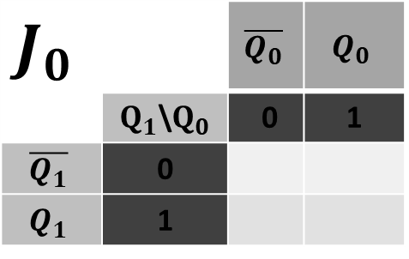
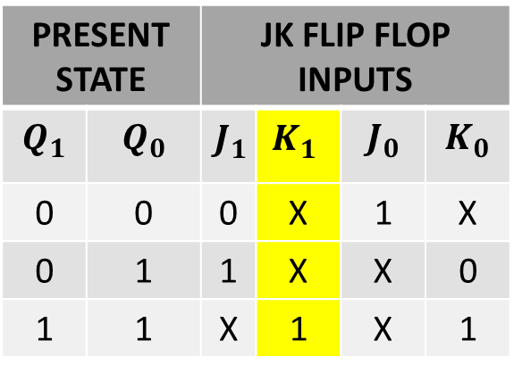
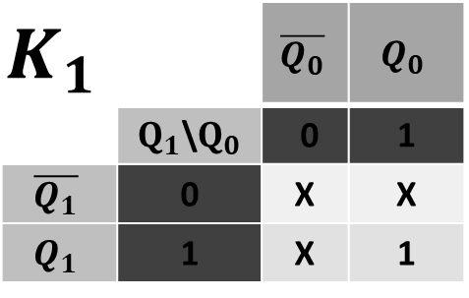
SIMPLIFICATION(K-MAP)
PRESENT STATE |  | JK FLIP FLOP INPUTS
$$Q_{1}$$ | $$Q_{0}$$ | $${J_{1}}_{ }$$ | $${K_{1}}_{ }$$ | $$J_{0}$$ | $$K_{0}$$
0 | 0 | 0 | X | 1 | X
0 | 1 | 1 | X | X | 0
1 | 1 | X | 1 | X | 1
$$J_{1}$$ |  | $$\overline{Q_{0}}$$ | $$Q_{0}$$
 | $Q_{1}$\$Q_{0}$ | 0 | 1
$$\overline{Q_{1}}$$ | 0 | 0 | 1
$$Q_{1}$$ | 1 | X | X
$$J_{0}$$ |  | $$\overline{Q_{0}}$$ | $$Q_{0}$$
 | $Q_{1}$\$Q_{0}$ | 0 | 1
$$\overline{Q_{1}}$$ | 0
$$Q_{1}$$ | 1
$$K_{1}$$ |  | $$\overline{Q_{0}}$$ | $$Q_{0}$$
 | $Q_{1}$\$Q_{0}$ | 0 | 1
$$\overline{Q_{1}}$$ | 0 | X | X
$$Q_{1}$$ | 1 | X | 1
$$K_{0}$$ |  | $$\overline{Q_{0}}$$ | $$Q_{0}$$
 | $Q_{1}$\$Q_{0}$ | 0 | 1
$$\overline{Q_{1}}$$ | 0
$$Q_{1}$$ | 1

Slide 15

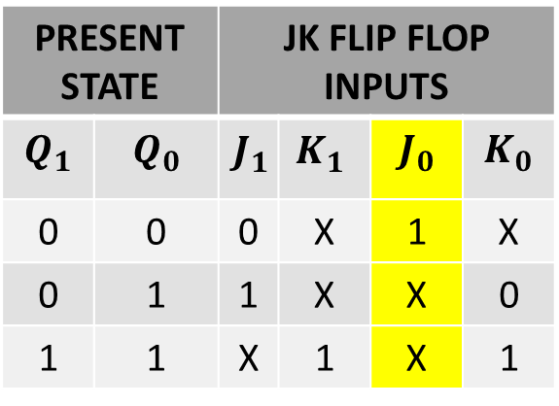
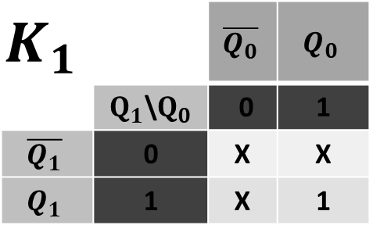
SIMPLIFICATION(K-MAP)
PRESENT STATE |  | JK FLIP FLOP INPUTS
$$Q_{1}$$ | $$Q_{0}$$ | $${J_{1}}_{ }$$ | $${K_{1}}_{ }$$ | $$J_{0}$$ | $$K_{0}$$
0 | 0 | 0 | X | 1 | X
0 | 1 | 1 | X | X | 0
1 | 1 | X | 1 | X | 1
$$J_{1}$$ |  | $$\overline{Q_{0}}$$ | $$Q_{0}$$
 | $Q_{1}$\$Q_{0}$ | 0 | 1
$$\overline{Q_{1}}$$ | 0 | 0 | 1
$$Q_{1}$$ | 1 | X | X
$$J_{0}$$ |  | $$\overline{Q_{0}}$$ | $$Q_{0}$$
 | $Q_{1}$\$Q_{0}$ | 0 | 1
$$\overline{Q_{1}}$$ | 0 | 1 | X
$$Q_{1}$$ | 1 | X | X
$$K_{1}$$ |  | $$\overline{Q_{0}}$$ | $$Q_{0}$$
 | $Q_{1}$\$Q_{0}$ | 0 | 1
$$\overline{Q_{1}}$$ | 0 | X | X
$$Q_{1}$$ | 1 | X | 1
$$K_{0}$$ |  | $$\overline{Q_{0}}$$ | $$Q_{0}$$
 | $Q_{1}$\$Q_{0}$ | 0 | 1
$$\overline{Q_{1}}$$ | 0
$$Q_{1}$$ | 1

Slide 16
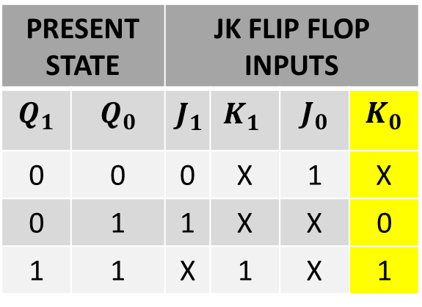
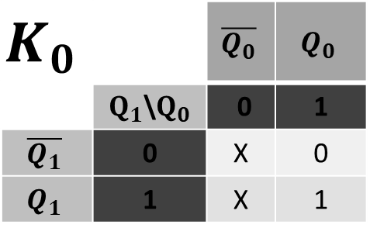
SIMPLIFICATION(K-MAP)
PRESENT STATE |  | JK FLIP FLOP INPUTS
$$Q_{1}$$ | $$Q_{0}$$ | $${J_{1}}_{ }$$ | $${K_{1}}_{ }$$ | $$J_{0}$$ | $$K_{0}$$
0 | 0 | 0 | X | 1 | X
0 | 1 | 1 | X | X | 0
1 | 1 | X | 1 | X | 1
$$J_{1}$$ |  | $$\overline{Q_{0}}$$ | $$Q_{0}$$
 | $Q_{1}$\$Q_{0}$ | 0 | 1
$$\overline{Q_{1}}$$ | 0 | 0 | 1
$$Q_{1}$$ | 1 | X | X
$$J_{0}$$ |  | $$\overline{Q_{0}}$$ | $$Q_{0}$$
 | $Q_{1}$\$Q_{0}$ | 0 | 1
$$\overline{Q_{1}}$$ | 0 | 1 | X
$$Q_{1}$$ | 1 | X | X
$$K_{1}$$ |  | $$\overline{Q_{0}}$$ | $$Q_{0}$$
 | $Q_{1}$\$Q_{0}$ | 0 | 1
$$\overline{Q_{1}}$$ | 0 | X | X
$$Q_{1}$$ | 1 | X | 1
$$K_{0}$$ |  | $$\overline{Q_{0}}$$ | $$Q_{0}$$
 | $Q_{1}$\$Q_{0}$ | 0 | 1
$$\overline{Q_{1}}$$ | 0 | X | 0
$$Q_{1}$$ | 1 | X | 1

Slide 17


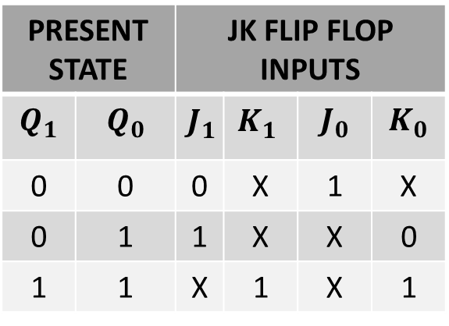


SIMPLIFICATION(K-MAP)
PRESENT STATE |  | JK FLIP FLOP INPUTS
$$Q_{1}$$ | $$Q_{0}$$ | $${J_{1}}_{ }$$ | $${K_{1}}_{ }$$ | $$J_{0}$$ | $$K_{0}$$
0 | 0 | 0 | X | 1 | X
0 | 1 | 1 | X | X | 0
1 | 1 | X | 1 | X | 1
$$J_{1}$$ |  | $$\overline{Q_{0}}$$ | $$Q_{0}$$
 | $Q_{1}$\$Q_{0}$ | 0 | 1
$$\overline{Q_{1}}$$ | 0 | 0 | 1
$$Q_{1}$$ | 1 | X | X
$$J_{0}$$ |  | $$\overline{Q_{0}}$$ | $$Q_{0}$$
 | $Q_{1}$\$Q_{0}$ | 0 | 1
$$\overline{Q_{1}}$$ | 0 | 1 | X
$$Q_{1}$$ | 1 | X | X
$${ J}_{1}{= }_{ }{ Q}_{0}$$
$${ J}_{0}{= }_{ }1$$
$$K_{1}$$ |  | $$\overline{Q_{0}}$$ | $$Q_{0}$$
 | $Q_{1}$\$Q_{0}$ | 0 | 1
$$\overline{Q_{1}}$$ | 0 | X | X
$$Q_{1}$$ | 1 | X | 1
$$K_{0}$$ |  | $$\overline{Q_{0}}$$ | $$Q_{0}$$
 | $Q_{1}$\$Q_{0}$ | 0 | 1
$$\overline{Q_{1}}$$ | 0 | X | 0
$$Q_{1}$$ | 1 | X | 1
$${ K}_{1}{= }_{ }1$$
$${ K}_{0}{= }_{ }Q_{1}$$

Slide 18




EQUATION
$${ J}_{1}{= }_{ }{ Q}_{0}$$
$${ K}_{1}{= }_{ }1$$
$${ J}_{0}{= }_{ }1$$
$${ K}_{0}{= }_{ }Q_{1}$$

Slide 19
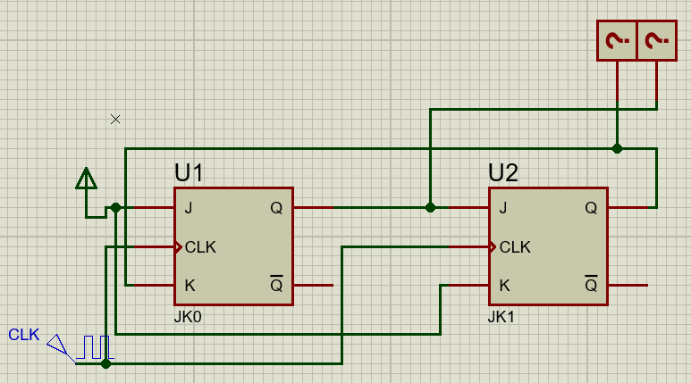
EQUATION

Slide 20
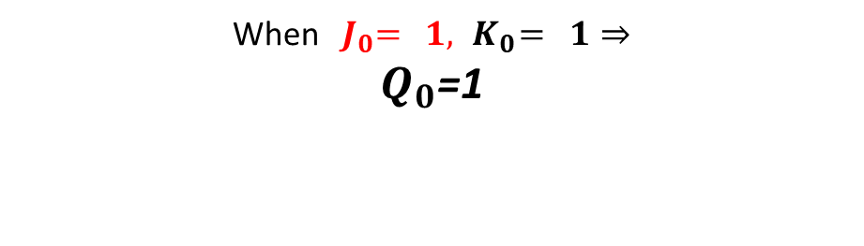


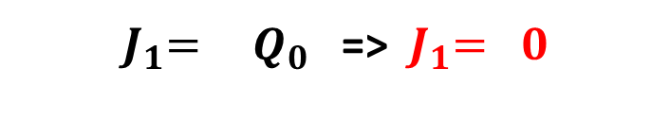
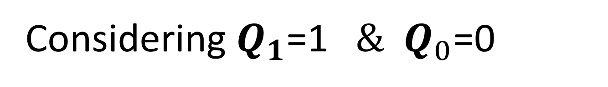
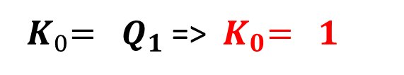

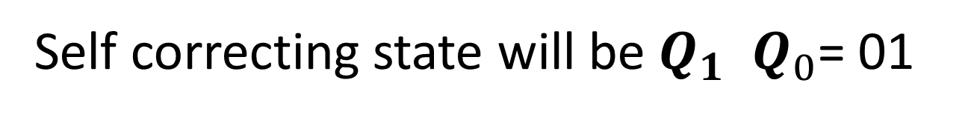
EQUATION
Considering $Q_{1}$=1 ${ \& Q}_{0}$=0
${ J}_{1}{= }_{ }{ Q}_{0}$ =>${ J}_{1}{= }_{ }0$
When ${ J}_{1}{= }_{ }0,{ K}_{1}{= }_{ }1⇒$
$Q_{1}$=0
$${ K}_{1}{= }_{ }1$$
$${ J}_{0}{= }_{ }1$$
${ K}_{0}{= }_{ }Q_{1}$ =>${ K}_{0}{= }_{ }1$
When ${ J}_{0}{= }_{ }1,{ K}_{0}{= }_{ }1⇒$
$Q_{0}$=1
Self correcting state will be $Q_{1}{ Q}_{0}$= 01

Slide 21
STATE DIAGRAM
UNUSED
STATE
00
10
Self Correction
01
11

Slide 22
STATE DIAGRAM
UNUSED
STATE
00
10
01
11

Slide 23
STATE DIAGRAM
UNUSED
STATE
$${Q_{1}Q}_{0}$$
0 0
$${Q_{1}Q}_{0}$$
1 0
$${Q_{1}Q}_{0}$$
0 1
$${Q_{1}Q}_{0}$$
1 1

Slide 24
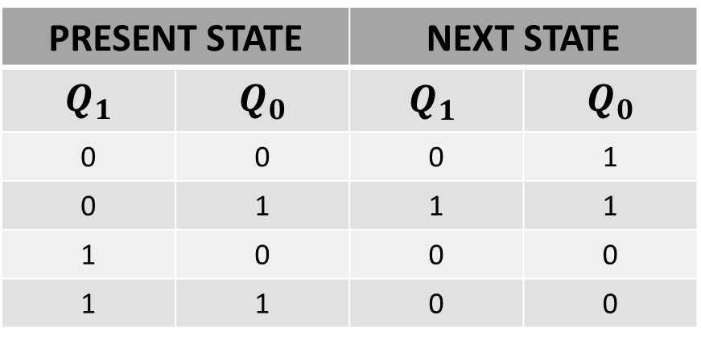
NEXT STATE TABLE
PRESENT STATE |  | NEXT STATE
$$Q_{1}$$ | $$Q_{0}$$ | $${Q_{1}}_{ }$$ | $$Q_{0}$$
0 | 0 | 0 | 1
0 | 1 | 1 | 1
1 | 0 | 0 | 0
1 | 1 | 0 | 0

Slide 25
NEXT STATE TABLE USING JK FLIP FLOP
$$Q_{t}$$ | $$Q_{t+1}$$ | J | K
0 | 0 | 0 | X
0 | 1 | 1 | X
1 | 0 | X | 1
1 | 1 | X | 0

Slide 26
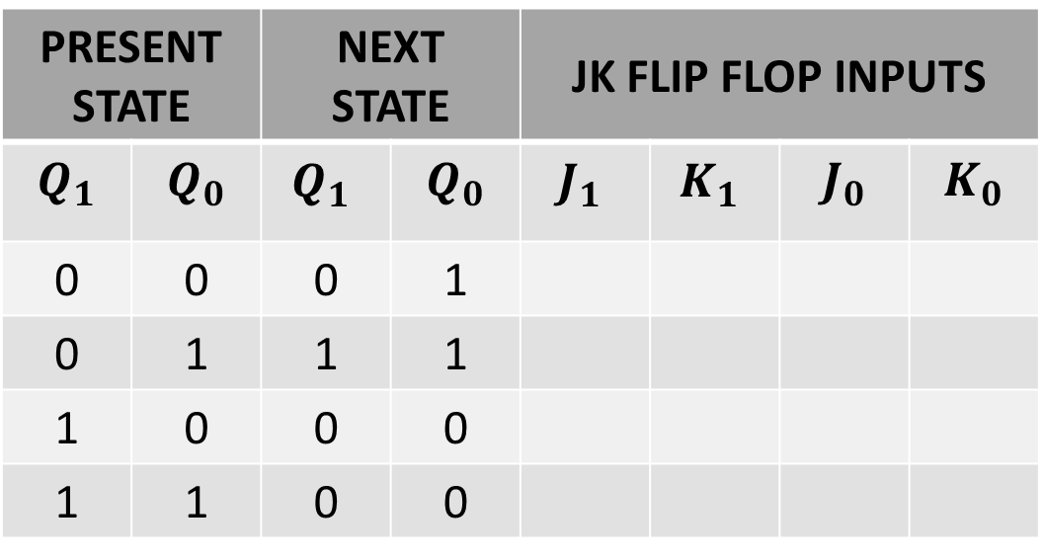
NEXT STATE TABLE
$$Q_{t}$$ | $$Q_{t+1}$$ | J | K
0 | 0 | 0 | X
0 | 1 | 1 | X
1 | 0 | X | 1
1 | 1 | X | 0
PRESENT STATE |  | NEXT STATE |  | JK FLIP FLOP INPUTS
$$Q_{1}$$ | $$Q_{0}$$ | $${Q_{1}}_{ }$$ | $$Q_{0}$$ | $${J_{1}}_{ }$$ | $${K_{1}}_{ }$$ | $$J_{0}$$ | $$K_{0}$$
0 | 0 | 0 | 1
0 | 1 | 1 | 1
1 | 0 | 0 | 0
1 | 1 | 0 | 0

Slide 27
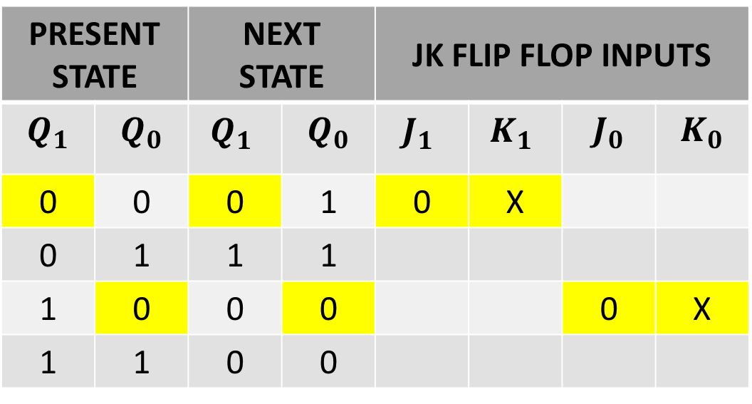
NEXT STATE TABLE
$$Q_{t}$$ | $$Q_{t+1}$$ | J | K
0 | 0 | 0 | X
0 | 1 | 1 | X
1 | 0 | X | 1
1 | 1 | X | 0
PRESENT STATE |  | NEXT STATE |  | JK FLIP FLOP INPUTS
$$Q_{1}$$ | $$Q_{0}$$ | $${Q_{1}}_{ }$$ | $$Q_{0}$$ | $${J_{1}}_{ }$$ | $${K_{1}}_{ }$$ | $$J_{0}$$ | $$K_{0}$$
0 | 0 | 0 | 1 | 0 | X
0 | 1 | 1 | 1
1 | 0 | 0 | 0 |  |  | 0 | X
1 | 1 | 0 | 0

Slide 28

NEXT STATE TABLE
$$Q_{t}$$ | $$Q_{t+1}$$ | J | K
0 | 0 | 0 | X
0 | 1 | 1 | X
1 | 0 | X | 1
1 | 1 | X | 0
PRESENT STATE |  | NEXT STATE |  | JK FLIP FLOP INPUTS
$$Q_{1}$$ | $$Q_{0}$$ | $${Q_{1}}_{ }$$ | $$Q_{0}$$ | $${J_{1}}_{ }$$ | $${K_{1}}_{ }$$ | $$J_{0}$$ | $$K_{0}$$
0 | 0 | 0 | 1 | 0 | X | 1 | X
0 | 1 | 1 | 1 | 1 | X
1 | 0 | 0 | 0 |  |  | 0 | X
1 | 1 | 0 | 0

Slide 29

NEXT STATE TABLE
$$Q_{t}$$ | $$Q_{t+1}$$ | J | K
0 | 0 | 0 | X
0 | 1 | 1 | X
1 | 0 | X | 1
1 | 1 | X | 0
PRESENT STATE |  | NEXT STATE |  | JK FLIP FLOP INPUTS
$$Q_{1}$$ | $$Q_{0}$$ | $${Q_{1}}_{ }$$ | $$Q_{0}$$ | $${J_{1}}_{ }$$ | $${K_{1}}_{ }$$ | $$J_{0}$$ | $$K_{0}$$
0 | 0 | 0 | 1 | 0 | X | 1 | X
0 | 1 | 1 | 1 | 1 | X
1 | 0 | 0 | 0 | X | 1 | 0 | X
1 | 1 | 0 | 0 | X | 1 | X | 1

Slide 30

NEXT STATE TABLE
$$Q_{t}$$ | $$Q_{t+1}$$ | J | K
0 | 0 | 0 | X
0 | 1 | 1 | X
1 | 0 | X | 1
1 | 1 | X | 0
PRESENT STATE |  | NEXT STATE |  | JK FLIP FLOP INPUTS
$$Q_{1}$$ | $$Q_{0}$$ | $${Q_{1}}_{ }$$ | $$Q_{0}$$ | $${J_{1}}_{ }$$ | $${K_{1}}_{ }$$ | $$J_{0}$$ | $$K_{0}$$
0 | 0 | 0 | 1 | 0 | X | 1 | X
0 | 1 | 1 | 1 | 1 | X | X | 0
1 | 0 | 0 | 0 | X | 1 | 0 | X
1 | 1 | 0 | 0 | X | 1 | X | 1

Slide 31

NEXT STATE TABLE
$$Q_{t}$$ | $$Q_{t+1}$$ | J | K
0 | 0 | 0 | X
0 | 1 | 1 | X
1 | 0 | X | 1
1 | 1 | X | 0
PRESENT STATE |  | NEXT STATE |  | JK FLIP FLOP INPUTS
$$Q_{1}$$ | $$Q_{0}$$ | $${Q_{1}}_{ }$$ | $$Q_{0}$$ | $${J_{1}}_{ }$$ | $${K_{1}}_{ }$$ | $$J_{0}$$ | $$K_{0}$$
0 | 0 | 0 | 1 | 0 | X | 1 | X
0 | 1 | 1 | 1 | 1 | X | X | 0
1 | 0 | 0 | 0 | X | 1 | 0 | X
1 | 1 | 0 | 0 | X | 1 | X | 1

Slide 32

NEXT STATE TABLE
$$Q_{t}$$ | $$Q_{t+1}$$ | J | K
0 | 0 | 0 | X
0 | 1 | 1 | X
1 | 0 | X | 1
1 | 1 | X | 0
PRESENT STATE |  | JK FLIP FLOP INPUTS
$$Q_{1}$$ | $$Q_{0}$$ | $${J_{1}}_{ }$$ | $${K_{1}}_{ }$$ | $$J_{0}$$ | $$K_{0}$$
0 | 0 | 0 | X | 1 | X
0 | 1 | 1 | X | X | 0
1 | 0 | X | 1 | 0 | X
1 | 1 | X | 1 | X | 1

Slide 33




SIMPLIFICATION(K-MAP)
PRESENT STATE |  | JK FLIP FLOP INPUTS
$$Q_{1}$$ | $$Q_{0}$$ | $${J_{1}}_{ }$$ | $${K_{1}}_{ }$$ | $$J_{0}$$ | $$K_{0}$$
0 | 0 | 0 | X | 1 | X
0 | 1 | 1 | X | X | 0
1 | 0 | X | 1 | 0 | X
1 | 1 | X | 1 | X | 1
$$J_{1}$$ |  | $$\overline{Q_{0}}$$ | $$Q_{0}$$
 | $Q_{1}$\$Q_{0}$ | 0 | 1
$$\overline{Q_{1}}$$ | 0 | 0 | 1
$$Q_{1}$$ | 1 | X | X
$$J_{0}$$ |  | $$\overline{Q_{0}}$$ | $$Q_{0}$$
 | $Q_{1}$\$Q_{0}$ | 0 | 1
$$\overline{Q_{1}}$$ | 0 | 1 | X
$$Q_{1}$$ | 1 | 0 | X
$${ J}_{1}{= }_{ }{ Q}_{0}$$
$${ J}_{0}{= }_{ }\overline{Q_{1}}$$
$$K_{1}$$ |  | $$\overline{Q_{0}}$$ | $$Q_{0}$$
 | $Q_{1}$\$Q_{0}$ | 0 | 1
$$\overline{Q_{1}}$$ | 0 | X | X
$$Q_{1}$$ | 1 | 1 | 1
$$K_{0}$$ |  | $$\overline{Q_{0}}$$ | $$Q_{0}$$
 | $Q_{1}$\$Q_{0}$ | 0 | 1
$$\overline{Q_{1}}$$ | 0 | X | 0
$$Q_{1}$$ | 1 | X | 1
$${ K}_{1}{= }_{ }1$$
$${ K}_{0}{= }_{ }Q_{1}$$

Slide 34



EQUATION
Considering $Q_{1}$=1 ${ \& Q}_{0}$=0
${ J}_{1}{= }_{ }{ Q}_{0}$ =>${ J}_{1}{= }_{ }0$
When ${ J}_{1}{= }_{ }0,{ K}_{1}{= }_{ }1⇒$
$Q_{1}$=0
$${ K}_{1}{= }_{ }1$$
${ J}_{0}{= }_{ }\overline{Q_{1}}$ =>${ J}_{1}{= }_{ }0$
${ K}_{0}{= }_{ }Q_{1}$ =>${ K}_{0}{= }_{ }1$
When ${ J}_{0}{= }_{ }0,{ K}_{0}{= }_{ }1⇒$
$Q_{0}$=1
Self correcting state will be $Q_{1}{ Q}_{0}$= 00

Slide 35
STATE DIAGRAM
UNUSED
STATE
00
10
01
11

Slide 36

PROTEUS SIMULATION

